Slide 1
Diagnóstico Organizacional

Slide 2
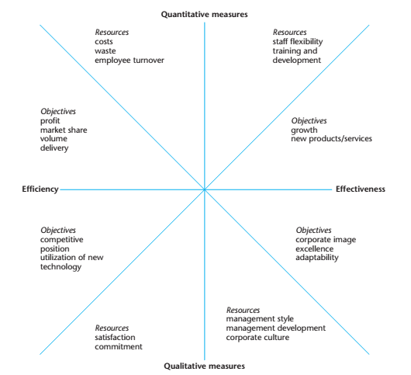

Slide 3
Diagnóstico Organizacional
5 - Fully supports corporate objectives.
4 - Adequately supports corporate objectives.
3 - Does not support corporate objectives.
2 - Makes achieving corporate objectives difficult.
1 - Makes achieving corporate objectives very difficult

Slide 4
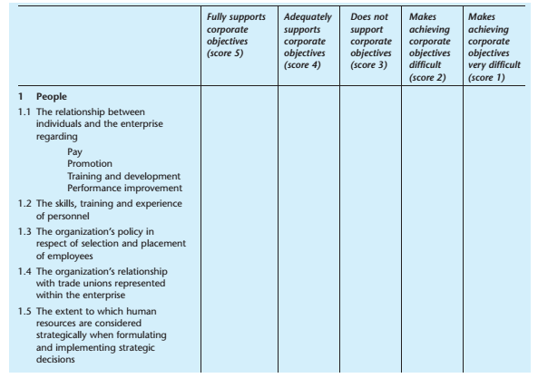

Slide 5
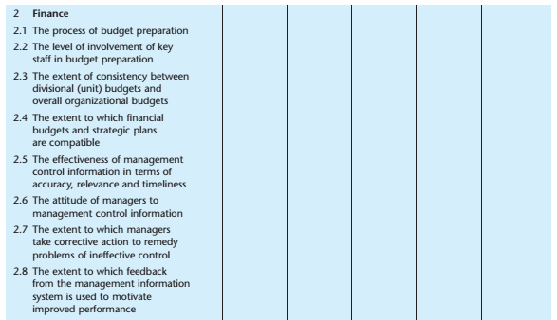

Slide 6
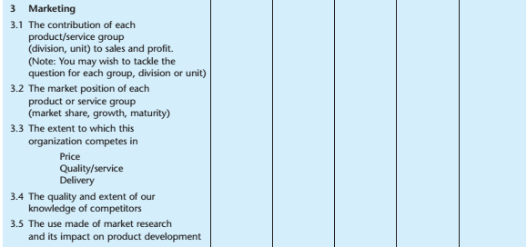

Slide 7
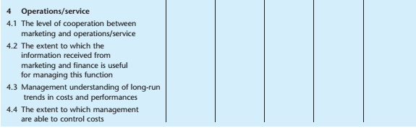
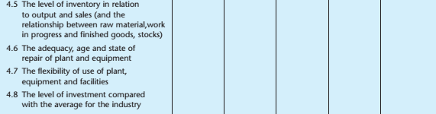

Slide 8
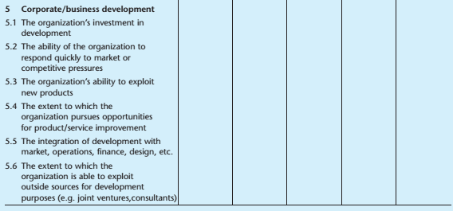

Slide 9
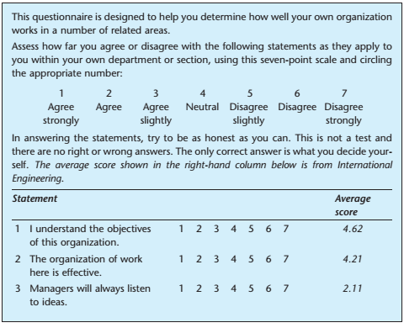
Inquérito de Diagnóstico Organizacional

Slide 10
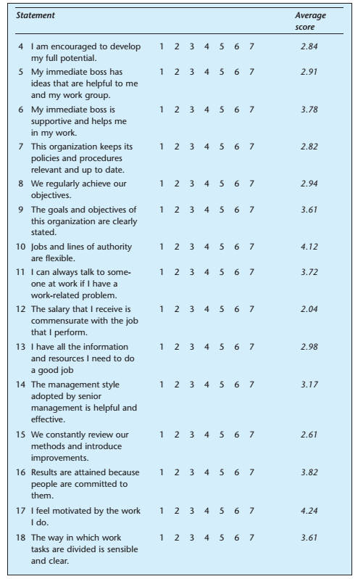

Slide 11
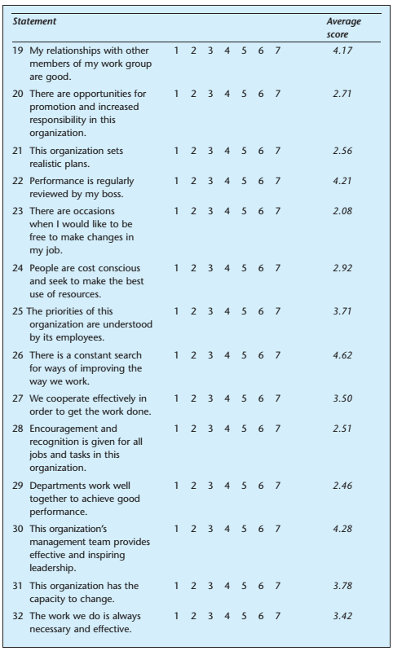

Slide 12
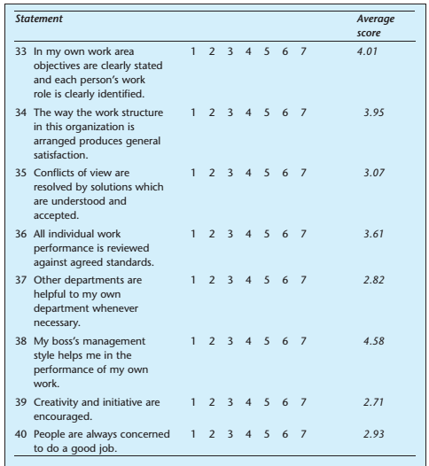

Slide 13
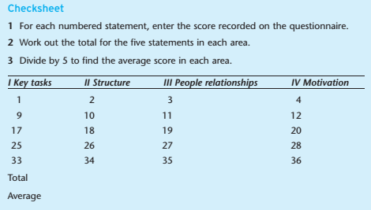
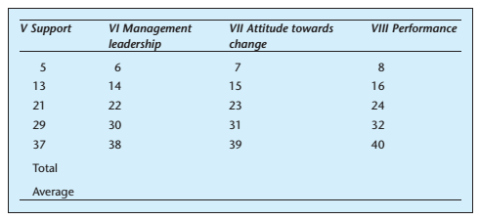

Slide 14
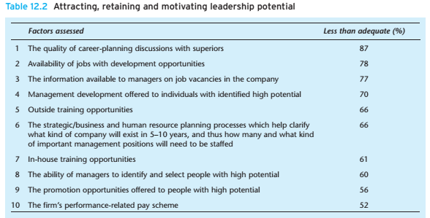
Diagnóstico de Gestores - Kotter

Slide 15
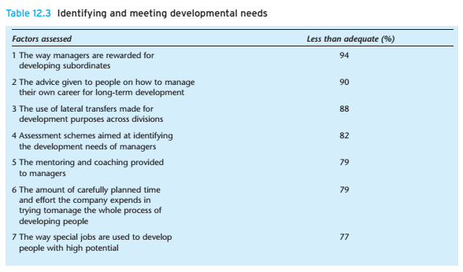

Slide 16
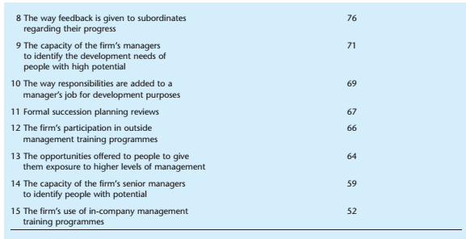

Slide 17
Opção | Custo | Benefício | Exequível | Controlo | Timing | Duração | Ranking

Slide 18
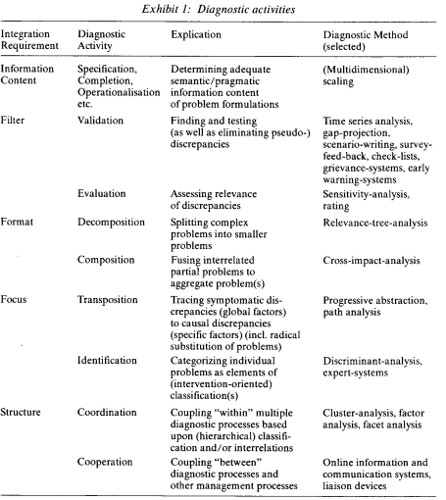

Slide 19
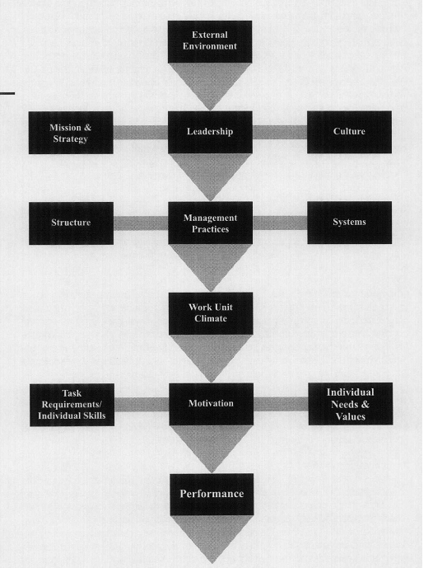

Slide 20
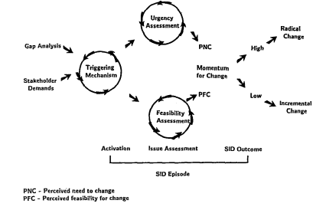
Strategic Issue Diagnosis

Slide 21
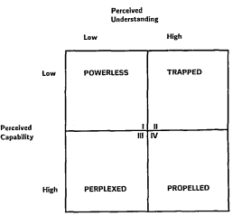
Feasibility Assessment

Slide 22
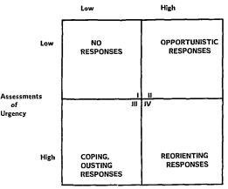
Urgency/Feasibility Assessment

Slide 23
Diagnosing Organizational Subsystems
Diagnostic targets | Information sought | Methods of Diagnosis
The total organization | Q) What is organization’s culture? Q) Are organizational goals and strategy understood and accepted? Q) What is organization’s performance? | Examination of organizational records – rules, regulations, policies Questionnaire survey Interviews (both group & individual)
Large and complex subsystems | Q) What are the unique demands on this subsystem? Q) Are organization structures and processes related to unique demands? Q) What are the major problems confronting this subsystem? | Questionnaire survey Interviews Observations Organization records
Small and simple subsystem | Q) What are major problems of the team? Q) How can team effectiveness be improved? Q) Do individuals know how their jobs relate to organizational goals? | Individual interviews group meeting to review the interview data Questionnaires Observation of staff meetings and other day- to-day operations
Intergroup subsystems | Q) How does each subsystem see the other? Q) What problems do the two groups have in working together? Q) How can they collaborate to improve performance of both groups? | Interviews of each subsystem followed by ‘sharing the data meeting’ Flowcharting critical processes Meetings between both groups
Individuals | Q) Do people perform according to organization’s expectations? Q) Do they need particular knowledge or skills? Q) What career development opportunities do they have/ want/ need? | Interviews Information from diagnostic meetings Data available with HR department
Roles | Q) Is the role defines adequately? Q) What is the ‘fit’ between person and role? Q) Is this the right person for this role? | Role analysis Observations Interviews

Slide 24
Diagnosing Organizational Processes
Organizational Processes | Information sought | Methods of Diagnosis
Communication patterns, styles & flows | Q) Is communication open or closed? Q) Is communication directed upward, downward, laterally? Q) Are communications filtered? ….. Why? How? | Observations – in meetings Questionnaires Interviews and discussion with group members
Goal setting | Q) Do people set goals? Q) Who participates? Q) Do they possess necessary skills for effective goal setting? | Questionnaires Interviews Observations
Decision making, problem solving & action planning | Q) Who makes decisions? Q) Are they effective? Q) Are additional decision making skills needed? | Observations of problem-solving meetings Analysis of videotaped sessions Organizational records
Conflict resolution and management | Q) Where does conflict exist? Q) Who are involved parties? Q) How is it being managed? | Interviews Flowcharting critical processes Meetings between both groups
Superior-subordinate relations | Q) What are the prevailing leadership styles? Q) What problems arise between superiors and subordinates? | Questionnaires Interviews
Strategic management & long range planning | Q) Who is responsible for ‘looking ahead’ and making long term decisions? Q) Do they have adequate tools and support? Q) Have the recent long range decisions been effective? | Interviews of key policy makers Group discussions Examination of historical records

Slide 25
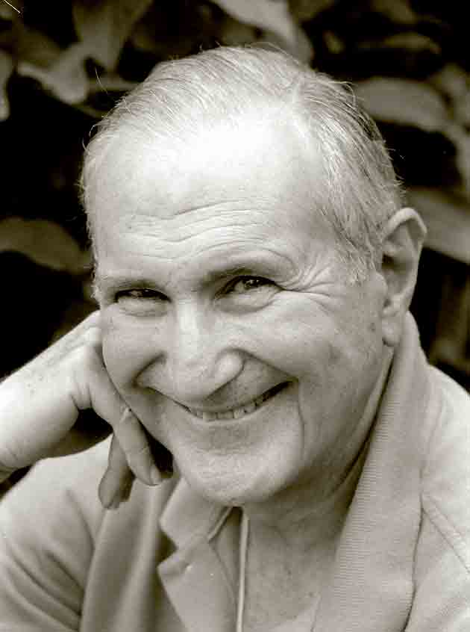
Diagnosis – The Six-Box Model
Purposes
Marvin Weisbord
Relationships
Structure
Weisbord identifies six critical areas where things must go right if organisation is to be successful. According to him, the consultant must attend to both formal and informal aspects of each box.
Leadership
Helpful
Mechanisms
Rewards
Environment
This model is still widely used by OD practitioners

Slide 26
Actions
Interventions are the actions taken to produce desired changes.
Four conditions that give rise to the need for OD interventions:
  The organisation has a problem
  (corrective action – to fix it)
  Organization sees an unrealized opportunity
  (enabling action – to seize the opportunity)
  Features of organization are out of alignment
  (alignment action – to get things back ‘in sync’)
  Yesterday’s vision is no longer good enough
  (action for new vision – actions to build necessary structures, processes and culture to make new vision a reality)

Slide 27
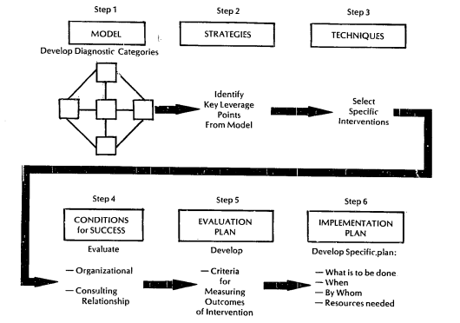
Do Diagnóstico à Intervenção

Slide 28
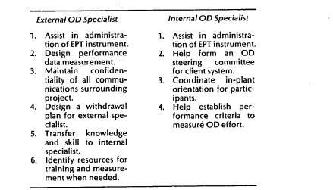
Especialistas Externos e Internos

Slide 29

Interventions
Major families of OD interventions:
  Diagnostic
  Team-Building
  Intergroup
  Education and Training
  Structural
  Process Consultation
  Grid Organization Development
  Third-Party Peace Making
  Coaching and Counseling
  Life and Career Planning
  Planning and Goal Setting
  Strategic Management
Each of these families of interventions includes many activities

Slide 30
Example : Team Building Interventions
Diagnostic meetings
Team building focused on goal setting, decision making, problem solving etc.
Building & mainitaining effective interpersonal relationships
Role analysis techniques for role clarification & defination
Intact work
teams
Team building
interventions
Team building focused on task accomplishment
Task allocations
Interunit conflicts
Role negotiation
Special teams

Slide 31
About Organization Development (OD)
Relatively new field of study – 50’s & 60’s
OD is about how organizations and people function and how to get them function better
Start Point – when the leader identifies an undesirable situation and seeks to change it.
Focus - Making organizations function better (total system change).
Orientation - Action (achieving results through planned activities).
No unifying theory – just models of practice
OD is an organization improvement strategy

Slide 32
Start Point
Poor alignment to organization’s strategy
Inappropriate organization structure
Low productivity
Poor quality
Poorly designed tasks
Poor morale
Organization
Intergroup conflict
Unclear goals
Organization Development
Poor team performance
Interpersonal conflicts
Inappropriate leadership style

Slide 33
Focus
Change – new state of things, different from old state of things
Can be viewed as an opportunity or as a threat
First order change
(making moderate adjustments)
Change
Second order change
(reinvent, reengineer, rewrite)
What needs to be changed and how to go about it
OD consultants are experts in organizational change

Slide 34

Orientation
Diagnosing
This process is known as
‘Action Research’
Taking Action
Three ingredients:
Participation
OD consultant (as collaborator & colearner)
Iterative process of diagnosis & action
Re-Diagnosing
Taking New Action
Change occurs based on the actions taken
New knowledge comes from examining the results of the actions.

Slide 35
Definition(s) of OD
Organization Development is an effort (1) planned, (2) organization-wide, and (3) managed from top, to (4) increase organization effectiveness and health through (5) planned interventions in organization’s “processes”, using behavioral-science knowledge. …Beckhard, 1969
Organization Development is a process of planned change – change of an organization’s culture from one which avoids an examination of social processes (especially decision making, planning and communication) to one which institutionalizes and legitimizes this examination. …Burke & Hornstein, 1972
Organization Development is a systematic application of behavioral science knowledge to the planned development and reinforcement of organizational strategies, structures, and processes for improving an organization’s effectiveness. …Cummings & Worley, 1993
Organization development is a planned process of change in an organization’s culture through the utilization of behavioral science technologies, research, and theory. …Burke, 1994

Slide 36
History of OD
(1) T-group
(2) Survey Feedback Technology
(3) Action research
(4) Sociotechnical & Socioclinical approaches
Four major stems of OD
(1) T-Group (Laboratory Training) – participants learn from their own actions and the group’s evolving dynamics
(2) Developing reliable questionnaires, collecting data from personnel, analyzing it for trends, and feeding the results back to everyone for action planning
(3) Diagnosing, taking action, re-diagnosing and taking new action
(4) Integrate social requirements of employees with technical requirements needed to do work in provided environment.

Slide 37
Revolutionary Values & Beliefs of OD
Organic systems (mutual confidence & trust) rather than mechanical systems (authority-obedience) …. Warren Bennis
Basic units of change are groups, not individuals …. Richard Beckhard
Away from resisting and fearing individual differences towards accepting and utilizing them …. Robert Tannenbaum
Trust and respect for individual
Open communication
Decentralized decision making
Collaboration and cooperation
Appropriate use of powers
Authentic interpersonal relationships
Radical departure from accepted values and beliefs of 1960’s

Slide 38
Second-Generation OD
Organization Transformation
Organizational Culture
Learning Organization
Total Quality Management
Visioning and Future Search
Business Process Reengineering
Quality of Work Life

Slide 39
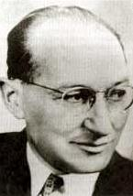
Models and theories
Change is a three-stage process
Stage 1- Unfreezing the old behavior/ situation
Stage 2 - Moving to a new level of behaviors
Stage 3 - Refreezing the behavior at the new level
Kurt Lewin
Edgar Schein modified this theory by specifying psychological mechanisms involved in each stage
Later Ronald Lippitt, Jeanne Watson and Bruce Westley expanded this model into seven-stage model

Slide 40
Models and theories Contd..
Seven stage model representing the consulting process
Phase 1
Developing a need for change.
Phase 2
Establishing the change relationship.
Phase 3
Diagnosing the client system’s problem.
Phase 4
Examining alternative routes, establishing goals and intentions of action.
Phase 5
Transforming intentions into actual change efforts.
Phase 6
Stabilizing change.
Phase 7
Achieving a terminal relationship.

Slide 41
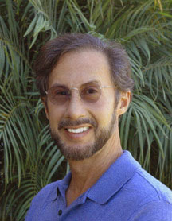

Models and theories Contd..
The culture track
The management skills track
The team-building track
The strategy-structure track
The reward system track
Ralph Kilmann
Five critical leverage points (tracks) for organization change
Track 1 : Enhances trust, communication, information sharing
Track 2 : Provide new ways of coping with complex problems
Track 3 : Infuses new culture and updated management skills
Track 4 : Develops revised strategy plan for organization
Track 5 : Establishes performance based reward system
Success
AT&T, Eastman Kodak, Ford, General Electric, Xerox etc.

Slide 42
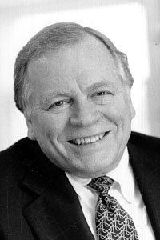
Models and theories Contd..
The Burke-Litwin Model of Organizational Change
Warner Burke
First order change (Transactional change)
Change
Second order change (Transformational change)
OD interventions directed towards structure, management practices, and systems (policies & procedures) result in first order change.
OD interventions directed towards mission and strategy, leadership, and organization culture result in second order change.

Slide 43
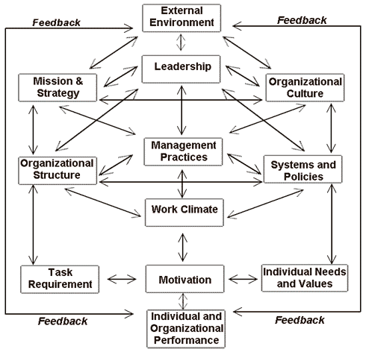
Models and theories Contd..
Transformational factors
Transactional factors

Slide 44
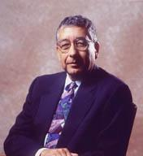
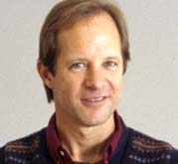
Models and theories Contd..
Porras & Robertson Model of Organizational Change
Jerry Porras
Peter Robertson
OD interventions alter features of the work setting causing changes in individuals’ behaviors, which in turn lead to individual and organizational improvements.
1
Organizing arrangements
Social factors
Physical setting
Technology
2
Work setting factors
3
4

Slide 45
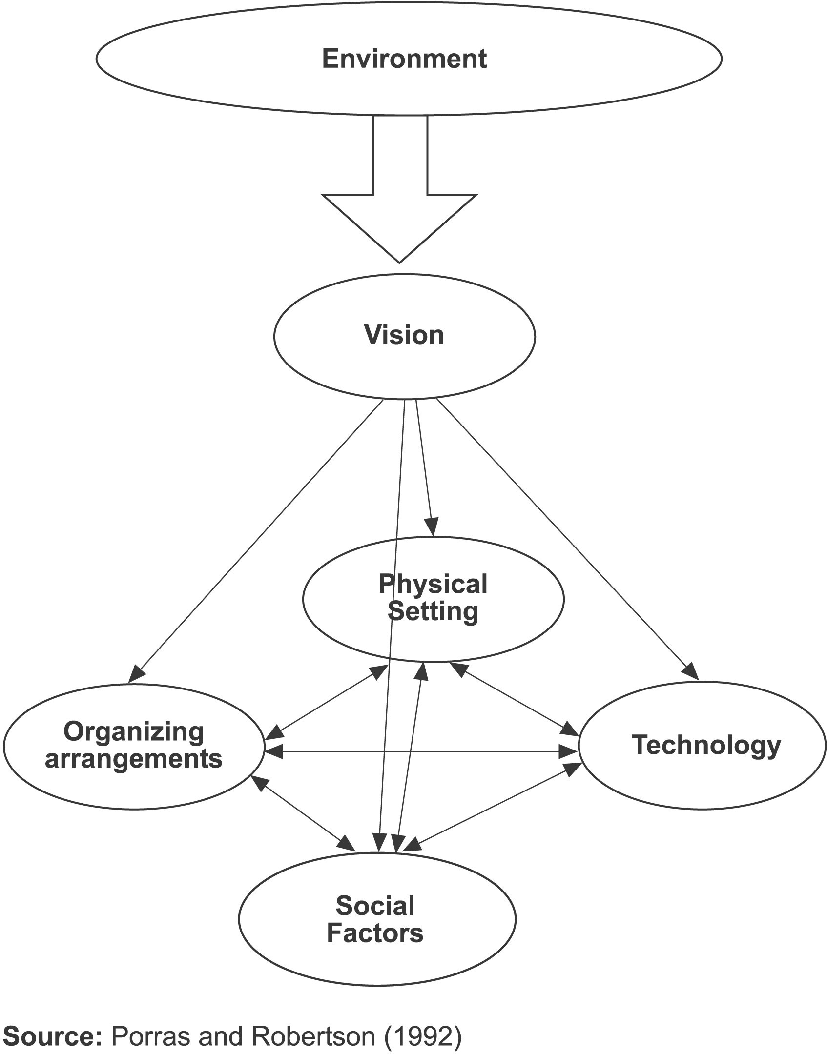
Models and theories Contd..
Organizing arrangements
Goals, strategies, structure, policies, procedures
Social Factors
Culture, management style, informal networks, individual attributes
Physical Settings
Space configuration, physical ambiance
Technology
Machinery, tools, IT, job design

Slide 46
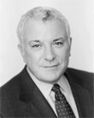
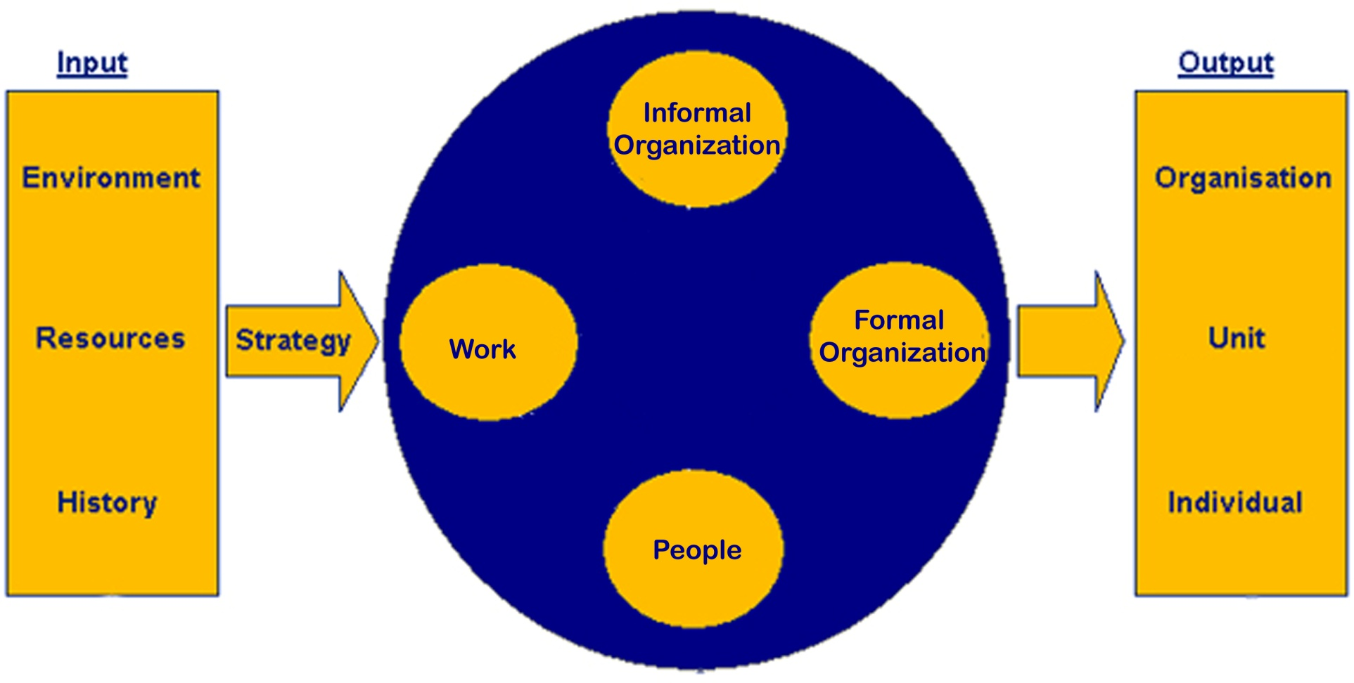
Systems Theory
Organizations are open systems in active exchange with their environment
David A. Nadler
The Congruence Model

Slide 47
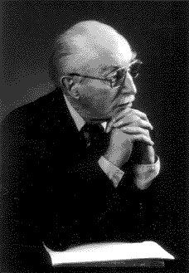
Systems Theory Contd..
Sociotechnical Systems Theory (STS)
All organizations comprised of two interdependent systems:
Social system
Technical system
Eric Trist
To achieve high productivity and employee satisfaction, organizations must optimize both systems.
Changes in one system affect the other system.

Slide 48
Participation & Empowerment
Participation in OD programs is not restricted to elites or top people; it is extended broadly throughout the organization.
Increased participation and empowerment have always been central goals and fundamental values of OD.
Participation enhances empowerment and empowerment in turn enhances performance.
Empowerment is the key to getting people to want to participate in change.

Slide 49
Teams & Teamwork
Many tasks are so complex that they cannot be performed by individuals; people must work together to accomplish them.
Putting those empowered individuals into teams creates extraordinary effects on performance.
Teams create synergy i.e. sum of efforts of team is far greater than sum of individual efforts.
A number of OD interventions are specifically designed to improve team performance. Examples – team building, quality circles etc.
Characteristics of successful teams
clear, elevating goal
result driven structure
competent members
unified commitment
collaborative climate
standards of excellence
external support and recognition
principled leadership
…..Larson & LaFasto

Slide 50
Parallel Learning Structures
A parallel learning structure consists of a steering committee and a number of working groups* that study what changes are needed, make recommendations of improvements, and monitor the change efforts.
(* Idea groups, action groups, implementation groups etc.)
One or more top executive should be part of steering committee
Representatives from all parts of the organization
In large bureaucratic organizations :
  High forces of inertia
  Hierarchical communication pattern
  Standard ways of addressing problems
  Here parallel learning structures are best way to initiate change
Inhibit :
learning
Innovation
Change

Slide 51
Normative-Reeducative Strategy of Change
Norms form the basis for behavior, and change comes through reeducation in which old norms are discarded and replaced by new ones.
Changes in normative orientations involve changes in:
Attitudes
Values
Skills
Relationships
Norms can be best changed by focusing on the group, not the individual.

Slide 52
Applied Behavioral Science
OD is an application of behavioral science
Pure/ Basic Science Applied Science
Generating knowledge Knowledge to Solve
practical problems
Practice Theory : Diagnosing the situation, then selecting and implementing treatments based on diagnosis, and finally evaluating the effects of the treatments.
Practice Research
Practice Theory
Applied Science
What helps me solve this problem?
Applied Behavioral Science
What helps me solve real problems?
Pure/ basic science
Behavioral Science Research
Behavioral Science Theory

Slide 53
Action Research
Data Collection
Feedback of data to client system members
Action planning based on the data
Taking action
Evaluating results of actions
Diagnostic
Participant
Empirical
Experimental
Types
Diagnostic
Participant
Empirical
Experimental
Researcher enters a problem situation, diagnoses it and make recommendations for remedial treatment (recommendations may not be put into effect by client group)
People who are to take action are involved in the entire process from the beginning (involvement increases the likelihood of carrying out the actions once decided upon)
Researcher keeps the systematic, extensive record of what he/ she did and what effects it had (may encounter situations too divergent from one another, which may not permit generalizations)
It is controlled research on the relative effectiveness of various techniques (is difficult to do when client wants immediate answers)

Slide 54

Managing the OD Process
Three basic components of OD programs:
Diagnosis | Continuous collection of data about total system, its subunits, its processes, and its culture
Action | All activities and interventions designed to improve the organization’s functioning
Program management | All activities designed to ensure success of the program

Slide 55
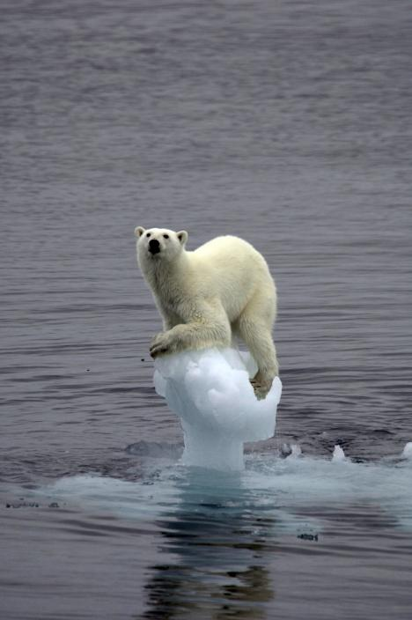
Program Management
Cummings and Worley identified 5 sets of activities required for effective change management:
Motivating Change
Creating a Vision
Effective Change
Management
Developing Political Support
Managing the Transition
Sustaining Momentum

Slide 56
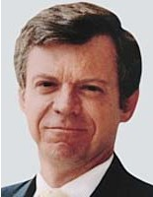
Program Management Contd..
Kotter’s 8-stage process for managing organizational change:
1
Establishing a sense of urgency
Creating a guiding coalition
Developing a vision and strategy
Communicating the change vision
Empowering a broad base of people to take action
Generating short term wins
Consolidating gains and producing even more change
Anchoring (institutionalizing) the new approaches into the culture
2
3
John P. Kotter
4
HBR, Mar-Apr 1995, p.61
5
6
7
8

